Slide 1

How should Aldi strengthen their position in the U.S. market?
Case Study: Aldi
Group A2:
Li, Xiang
Tseng, Thomas
Xu, Hong
Yang, Xingyu
Yang, Xuechun
30th Oct 2017
Zürich, Switzerland

Slide 2
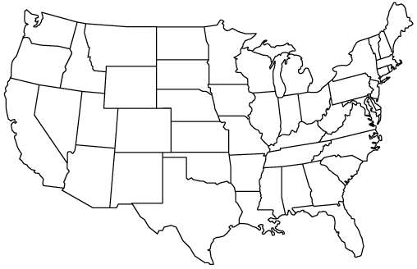
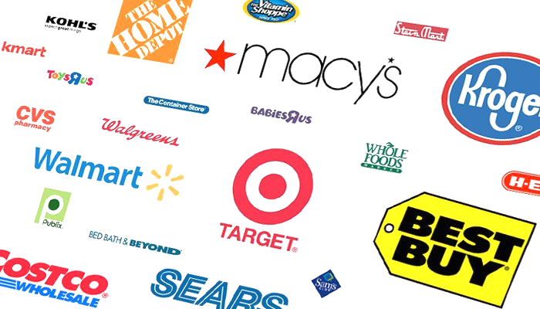

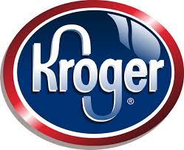
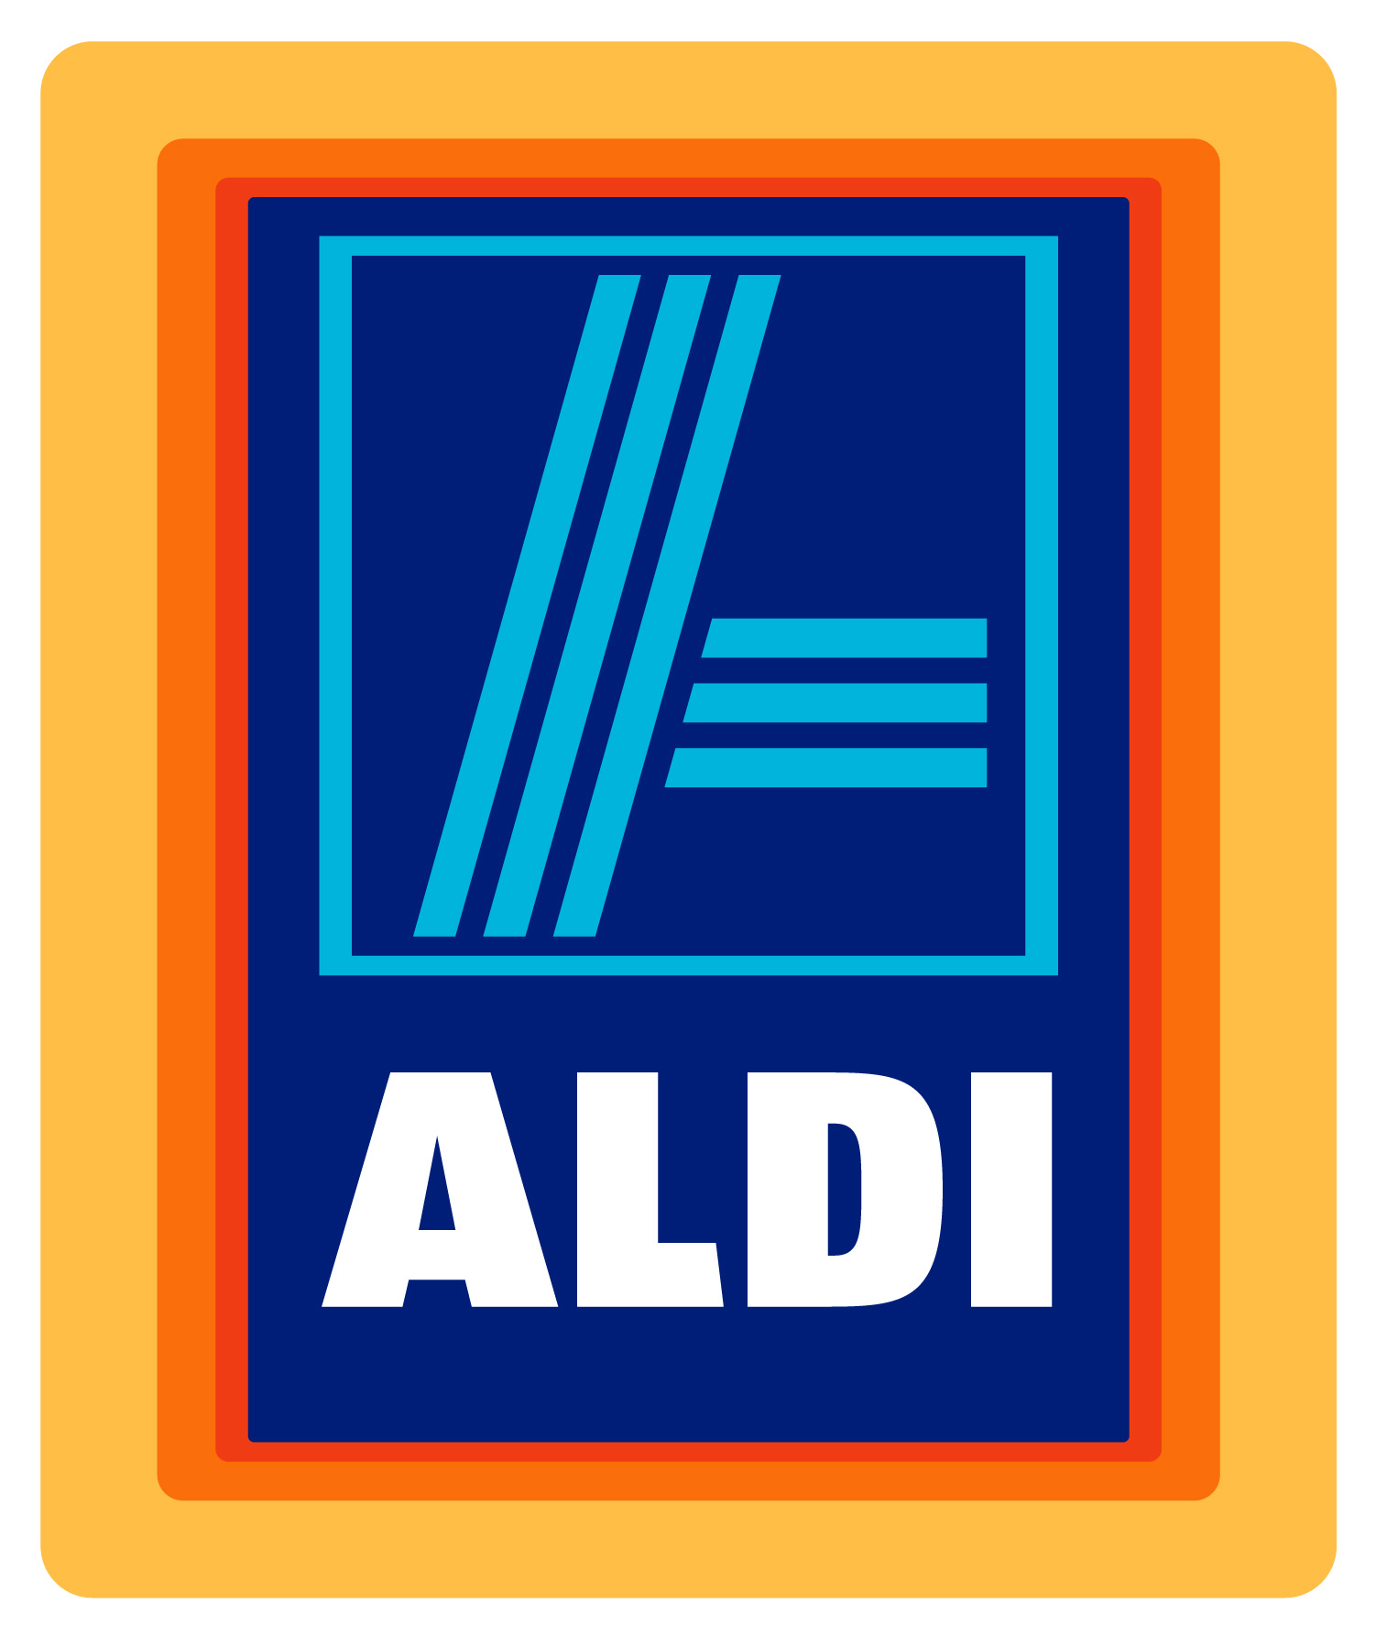
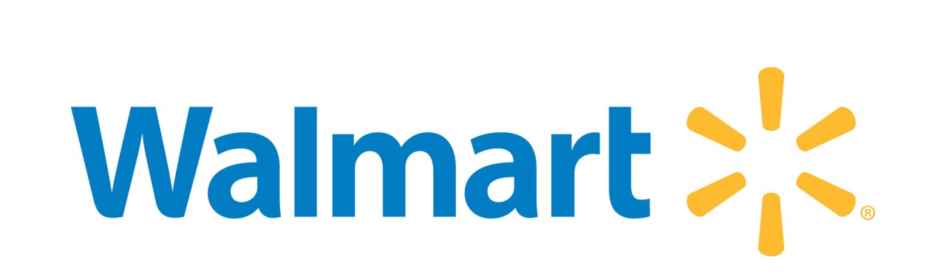
Our Problem Statement
How should Aldi strengthen their position in the U.S. market?
Fierce competition in U.S. retailer industry
Expand?
Which segment of the retailer industry should Aldi focus on for their expansion？
How should Aldi compete in the U.S. market?
Notes:
Aldi - the world's 8th largest retailer(dark horse discounter) - planned to accelerate its US expansion. However, it faces fierce internal and external competition from retail companies such as walmart, kroger. How should Aldi compete with these competitors, should they expand their offering to the department store industry like Walmart, or should they stick with groceries?
Already exist, but not famous;
they want to expand, how should they do in the US market;
Should they stay in GS;
How to compete;

Slide 3
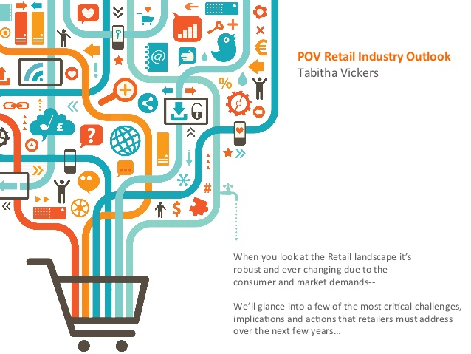
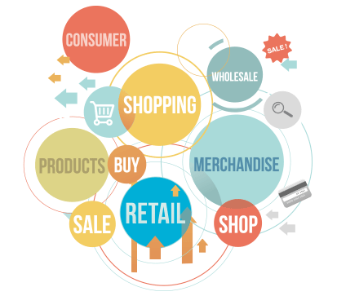
Presentation Overview
Introduction: U.S. Retail Industry
Grocery Store Industry
KPIs and key characteristics
Porter's 5 Forces
Industry Overview
Department Store Industry
KPIs and key characteristics
Porter's 5 Forces
Industry Overview
Comparison Grocery vs. Department Store
Aldi
Aldi in the Grocery Store Industry
Aldi SWOT Analysis
Recommendation
Strengthen Grocery Store Presence
Store Location
Online Presence
Organic Food Line
U.S. Customer Behavior
Summary

Slide 4



Retail Industry Analysis
Introduction: U.S. Retail Industry
Grocery Store Industry
KPIs and key characteristics
Porter's 5 Forces
Industry Overview
Department Store Industry
KPIs and key characteristics
Porter's 5 Forces
Industry Overview
Comparison Grocery vs. Department Store
Aldi
Aldi in the Grocery Store Industry
Aldi SWOT Analysis
Recommendation
Strengthen Grocery Store Presence
Store Location
Online Presence
Organic Food Line
U.S. Customer Behavior
Summary

Slide 5
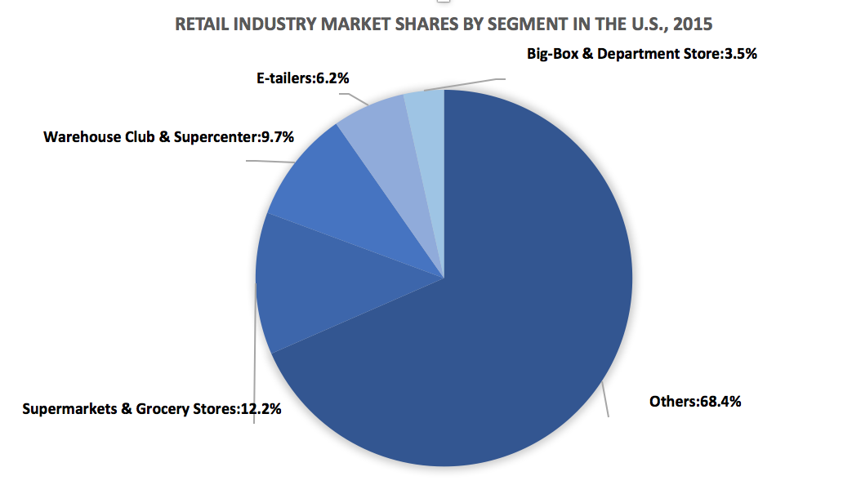
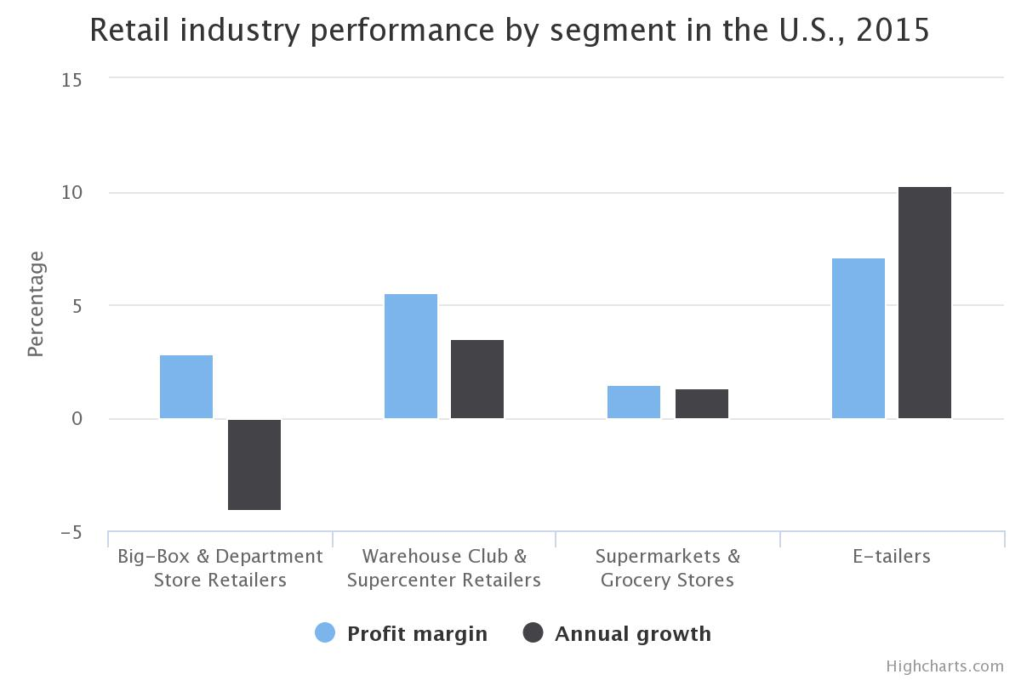
Introduction to Retail Industry in the U.S.
Definition and performance
The retail industry
U.S. retail industry
is a sector of the economy that is comprised of individuals and companies engaged in the selling of finished products to end consumers.
features the largest number of large, lucrative retailers in the world. In 2016, U.S. retail sales reached $4952.63 billions, 20.8% of worldwide retail sales.
Average profit margin: 4%
Average annual growth:3.2%
Source: Anon, (2017). “2015 Retail Industry Report”. [online] Available at: http://www.globalmna.com/assets/2015retailindustryreport.pdf [Accessed 29 Oct. 2017].
Notes:
An industry in which various types of retailers selling consumer goods or services to end customers through multiple channels of distribution.
2016: 4952.63, 3.5%, 20.8%
The United States retail sector features the largest number of large, lucrative retailers in the world.
An estimated two-thirds of the U.S. gross domestic product (GDP) comes from retail consumption.
In U.S., there are mainly 4 types of retailers: Big-box & Department Store Retailers, Warehouse Club & Supercenter Retailer, Supermarket & Grocery Stores, E-tailers.o
Big-box and department stores retail a broad range of general merchandise, such as apparel, jewelry, cosmetics, home furnishings, general household products, toys, appliances and sporting goods.
Warehouse Club & Supercenter Retailers have large stores that primarily retail a general line of grocery products, along with merchandise items (e.g., apparel and appliances).
The Supermarkets & Grocery Stores segment sells general lines of food products, including fresh and prepared meats, poultry and seafood, canned and frozen foods, fresh fruits and vegetables and various dairy products.
E-tailers sell retail goods on the Internet.

Slide 6
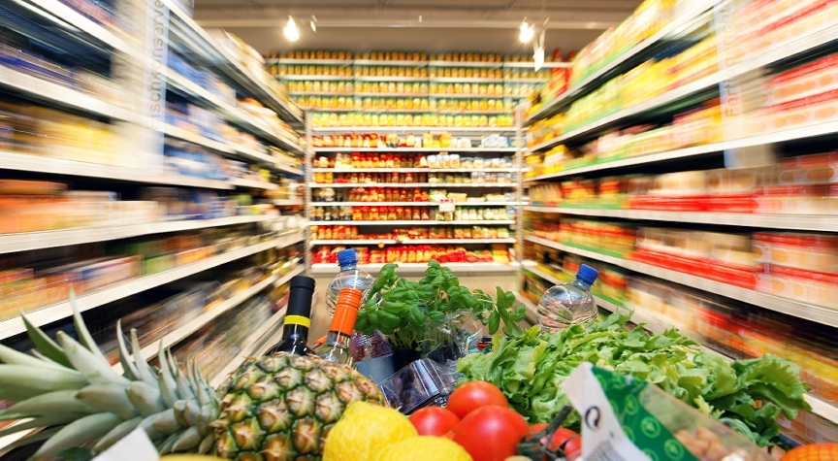
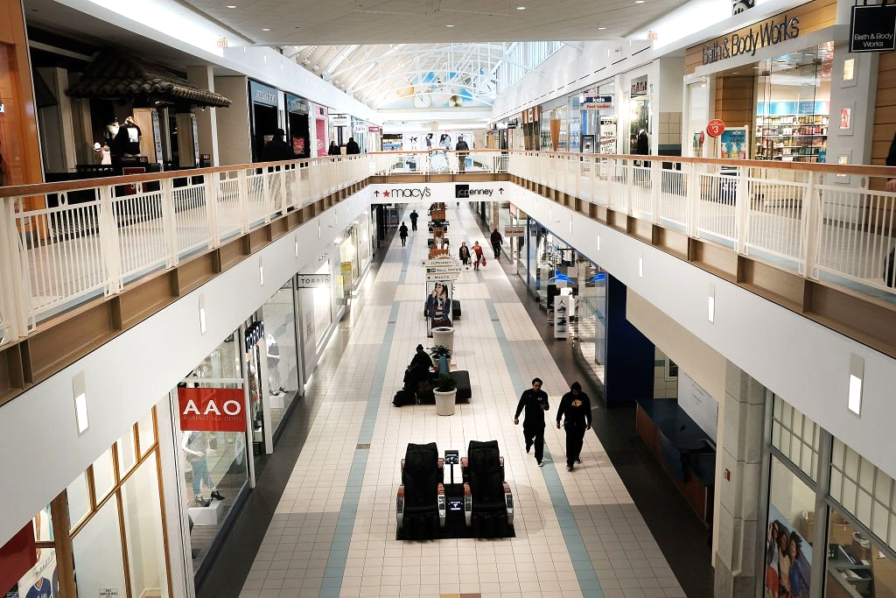

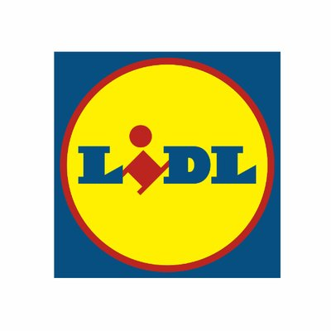

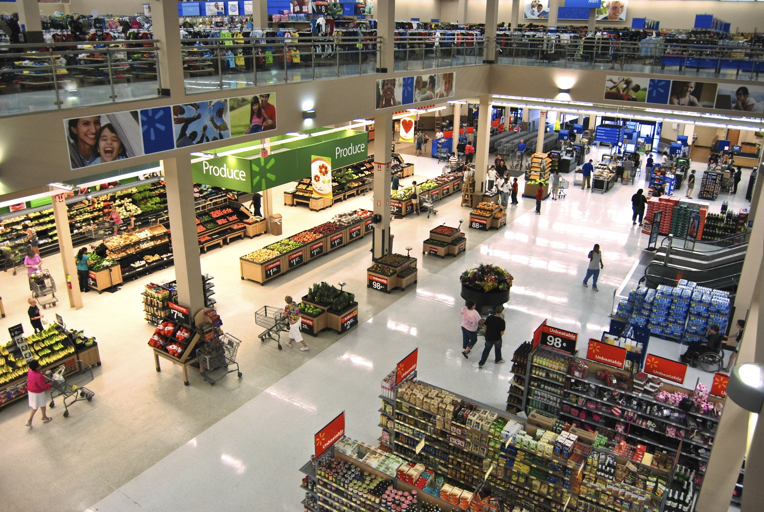
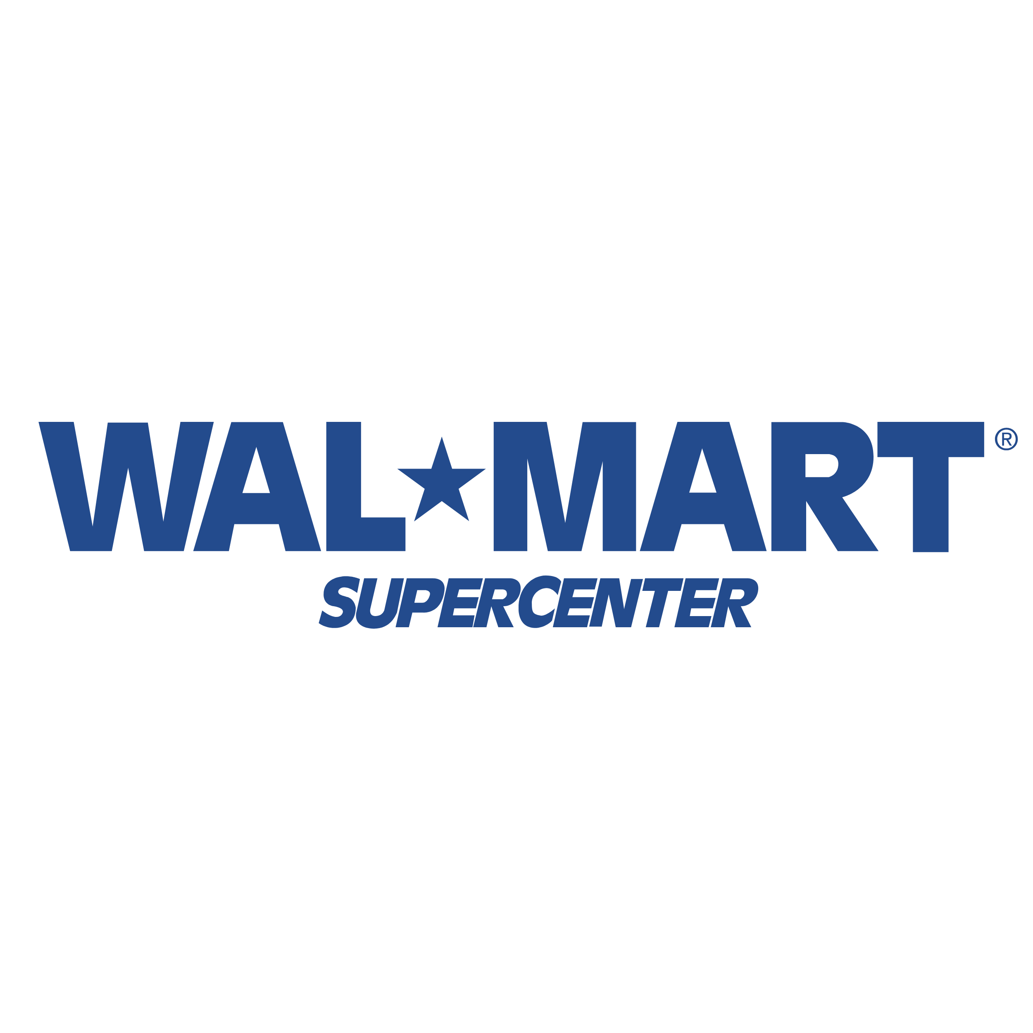
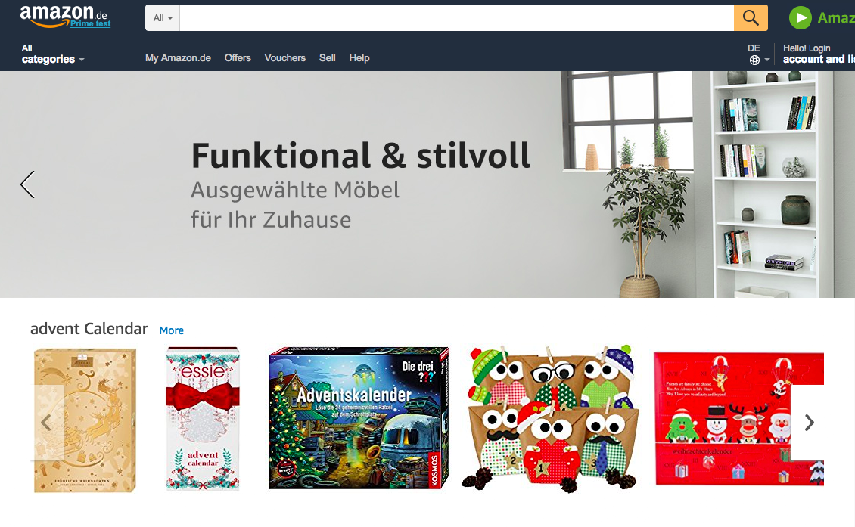

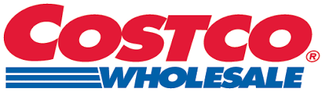

Retail Industry Segments
Grocery store
Department store
Supercenter
E-tailers

Slide 7
Introduction to Retail Industry in the U.S.
Definition and performance
The retail industry
U.S. retail industry
is a sector of the economy that is comprised of individuals and companies engaged in the selling of finished products to end users / consumers.
features the largest number of large, lucrative retailers in the world. In 2016, U.S. retail sales reached $4952.63 billions, 20.8% of worldwide retail sales.
Profit margin: 2.8%
Annual growth: -4.1%
Notes:
An industry in which various types of retailers selling consumer goods or services to end customers through multiple channels of distribution.
2016: 4952.63, 3.5%, 20.8%
The United States retail sector features the largest number of large, lucrative retailers in the world.
An estimated two-thirds of the U.S. gross domestic product (GDP) comes from retail consumption.
In U.S., there are mainly 4 types of retailers: Big-box & Department Store Retailers, Warehouse Club & Supercenter Retailer, Supermarket & Grocery Stores, E-tailers.o
Big-box and department stores retail a broad range of general merchandise, such as apparel, jewelry, cosmetics, home furnishings, general household products, toys, appliances and sporting goods.
Warehouse Club & Supercenter Retailers have large stores that primarily retail a general line of grocery products, along with merchandise items (e.g., apparel and appliances).
The Supermarkets & Grocery Stores segment sells general lines of food products, including fresh and prepared meats, poultry and seafood, canned and frozen foods, fresh fruits and vegetables and various dairy products.
E-tailers sell retail goods on the Internet.

Slide 8
Introduction to Retail Industry in the U.S.
Definition and performance
The retail industry
U.S. retail industry
is a sector of the economy that is comprised of individuals and companies engaged in the selling of finished products to end users / consumers.
features the largest number of large, lucrative retailers in the world. In 2016, U.S. retail sales reached $4952.63 billions, 20.8% of worldwide retail sales.
Profit margin: 1.5%
Annual growth: 1.3%
Notes:
An industry in which various types of retailers selling consumer goods or services to end customers through multiple channels of distribution.
2016: 4952.63, 3.5%, 20.8%
The United States retail sector features the largest number of large, lucrative retailers in the world.
An estimated two-thirds of the U.S. gross domestic product (GDP) comes from retail consumption.
In U.S., there are mainly 4 types of retailers: Big-box & Department Store Retailers, Warehouse Club & Supercenter Retailer, Supermarket & Grocery Stores, E-tailers.o
Big-box and department stores retail a broad range of general merchandise, such as apparel, jewelry, cosmetics, home furnishings, general household products, toys, appliances and sporting goods.
Warehouse Club & Supercenter Retailers have large stores that primarily retail a general line of grocery products, along with merchandise items (e.g., apparel and appliances).
The Supermarkets & Grocery Stores segment sells general lines of food products, including fresh and prepared meats, poultry and seafood, canned and frozen foods, fresh fruits and vegetables and various dairy products.
E-tailers sell retail goods on the Internet.

Slide 9
Introduction to Retail Industry in the U.S.
Definition and performance
The retail industry
U.S. retail industry
is a sector of the economy that is comprised of individuals and companies engaged in the selling of finished products to end users / consumers.
features the largest number of large, lucrative retailers in the world. In 2016, U.S. retail sales reached $4952.63 billions, 20.8% of worldwide retail sales.
Profit margin: 5.5%
Annual growth: 3.5%
Notes:
An industry in which various types of retailers selling consumer goods or services to end customers through multiple channels of distribution.
2016: 4952.63, 3.5%, 20.8%
The United States retail sector features the largest number of large, lucrative retailers in the world.
An estimated two-thirds of the U.S. gross domestic product (GDP) comes from retail consumption.
In U.S., there are mainly 4 types of retailers: Big-box & Department Store Retailers, Warehouse Club & Supercenter Retailer, Supermarket & Grocery Stores, E-tailers.o
Big-box and department stores retail a broad range of general merchandise, such as apparel, jewelry, cosmetics, home furnishings, general household products, toys, appliances and sporting goods.
Warehouse Club & Supercenter Retailers have large stores that primarily retail a general line of grocery products, along with merchandise items (e.g., apparel and appliances).
The Supermarkets & Grocery Stores segment sells general lines of food products, including fresh and prepared meats, poultry and seafood, canned and frozen foods, fresh fruits and vegetables and various dairy products.
E-tailers sell retail goods on the Internet.

Slide 10

Grocery Store Industry Analysis
Introduction: U.S. Retail Industry
Grocery Store Industry
KPIs and key characteristics
Porter's 5 Forces
Industry Overview
Department Store Industry
KPIs and key characteristics
Porter's 5 Forces
Industry Overview
Comparison Grocery vs. Department Store
Aldi
Aldi in the Grocery Store Industry
Aldi SWOT Analysis
Recommendation
Strengthen Grocery Store Presence
Store Location
Online Presence
Organic Food Line
U.S. Customer Behavior
Summary

Slide 11
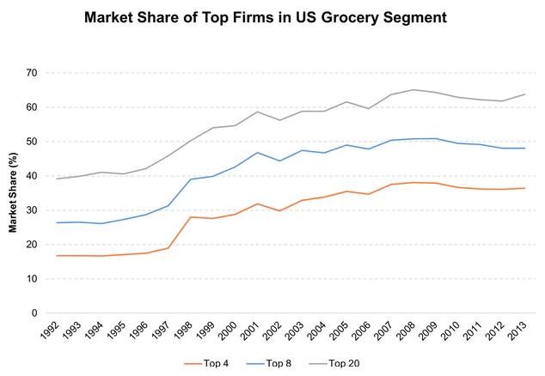
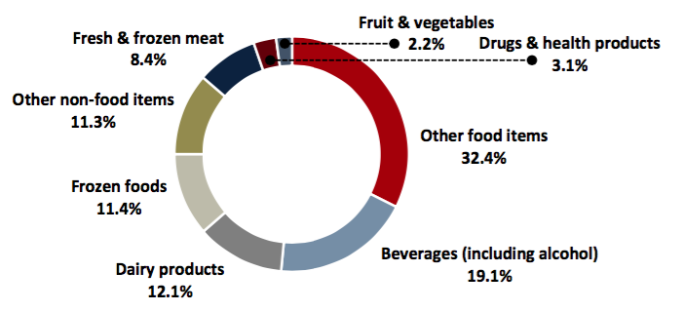
Grocery Industry in the U.S.
Grocery store is a retail store that primarily sells food
Grocery stores in the U.S. accounted for 90% of the country’s food and beverage store sales.
Top four players’ sales of the total grocery industry has increased from 17% in 1992 to around 31% in 2015.
Major product segmentation(2015)
Top four players:
(31%)
The Kroger Co. (15.4%)
Safeway (6.6%)
Publix Super (5.5%)
Delhaize America LLC.
Main players:
(69%)
Small- to medium-sized local market operators.
The grocery industry is mature.
Annual revenue: 584.3 billion
Profit margin: 1.5%
Annual growth: 1.3%
Stores number: 65, 000
Employee number: 3.4 million
The grocery industry is fragmented:
The overwhelming majority of these retailers are small businesses.
In the Future, the grocery industry will be consolidated:
Driven by merger and acquisition activity among the leading operators.
Source: Anon, (2017). “2015 Retail Industry Report”. [online] Available at: http://www.globalmna.com/assets/2015retailindustryreport.pdf [Accessed 29 Oct. 2017].； The Kroger Co.: From Corner Store to Supermarket Giant Available at http://marketrealist.com/2015/10/online-grocery-retail-a-future-sales-driver-for-kroger/
Notes:
This increase in market share was due to the continuous consolidation of the supermarket segment. Benefit from economies of scale
A grocery store (coop) is a retail store that primarily sells food. See graph: product and service segmentation(2015)
A grocer is a bulk seller of food. Grocery stores often offer non-perishable food that is packaged in bottles, boxes, and cans; some also have bakeries, butchers, delis, and fresh produce. Large grocery stores that stock significant amounts of non-food products, such as clothing and household items, are called supermarkets. Some large supermarkets also include a pharmacy, and customer service, redemption, and electronics sections.
Currently: segment revenue increased at an average annual rate of 1.3% to $584.3 billion over the five years to 2015.
65,000 stores, 470B,
There has been an increase in market concentration in the US grocery segment. The top four players, which accounted for 17% of the total industry sales in 1992, had a larger piece of the pie—around 36%—in 2013.
Main channel: supermarket(⅓ market share, $365b annual sales in 2015)
Key players: Walmart Stores (WMT), The Kroger Co. (KR), Safeway, and Publix Super Markets were the top four players in 2013. This increase in market share was due to the continuous consolidation of the supermarket segment.

Slide 12
Grocery Industry in the U.S.
Porter’s Five Forces
Threats of New Entrants
Threats of Substitutes
Low barrier to entry
No license required
Low taxes, low initial investment
New entrants lack competitiveness
Life cycle stage(mature)
Consolidation of market
Internal substitute: healthier food
Local farmers
Natural and organic food
External substitute: cheaper, convenience
Warehouse clubs, supercenters
One-stop-shop
Intensity of Competitive Rivalry
e.g. The Kroger.Co
Safeway Inc
Low market concentration.
Low diversity of competitors.
Homogeneous products.
→ FIerce competition
→ Price war
Low bargaining power of suppliers
High switching cost of suppliers
Agriculture market is fragmented
Expanding supply chain
High customer bargaining power
low switching cost of customers
Well informed about the product
Price sensitive
Bargaining Power of Suppliers
Bargaining Power of Buyers
Notes:
First show whole 5 forces, then illustrate each part with detailed figures and summary key features. At the end, gather all the key features and give some conclusion.
Homogenous product -- High competition -- Price war, possible to think of private label to build brand loyalty thus to compete with homogenous product.
In the largest metropolitan areas, the four largest food retailers -- Wal-Mart, Kroger, Costco and Supervalu -- controlled over 70% of the sales.
A Wal-Mart spokesperson said customers are loyal to its private brands, "both in-store and online." "While we are the largest private-brand player in the U.S., we've spent a lot of effort to invest in product development, sourcing, technology and new talent to be able to build an even better business," the spokesperson said in a statement. "These brands help us deliver great prices for our customers, innovative products and quality items that we know our customers are going to love."
*High suppliers switching cost due to loss of volume and profitability.
High suppliers’ concentration due to emerging substitute inputs.
→ company has high negotiation power
New distribution channels → high suppliers’ bargaining power.

Slide 13
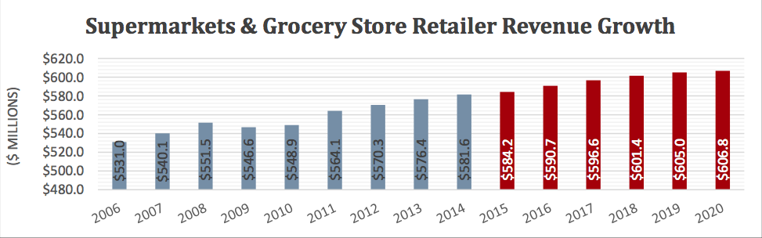
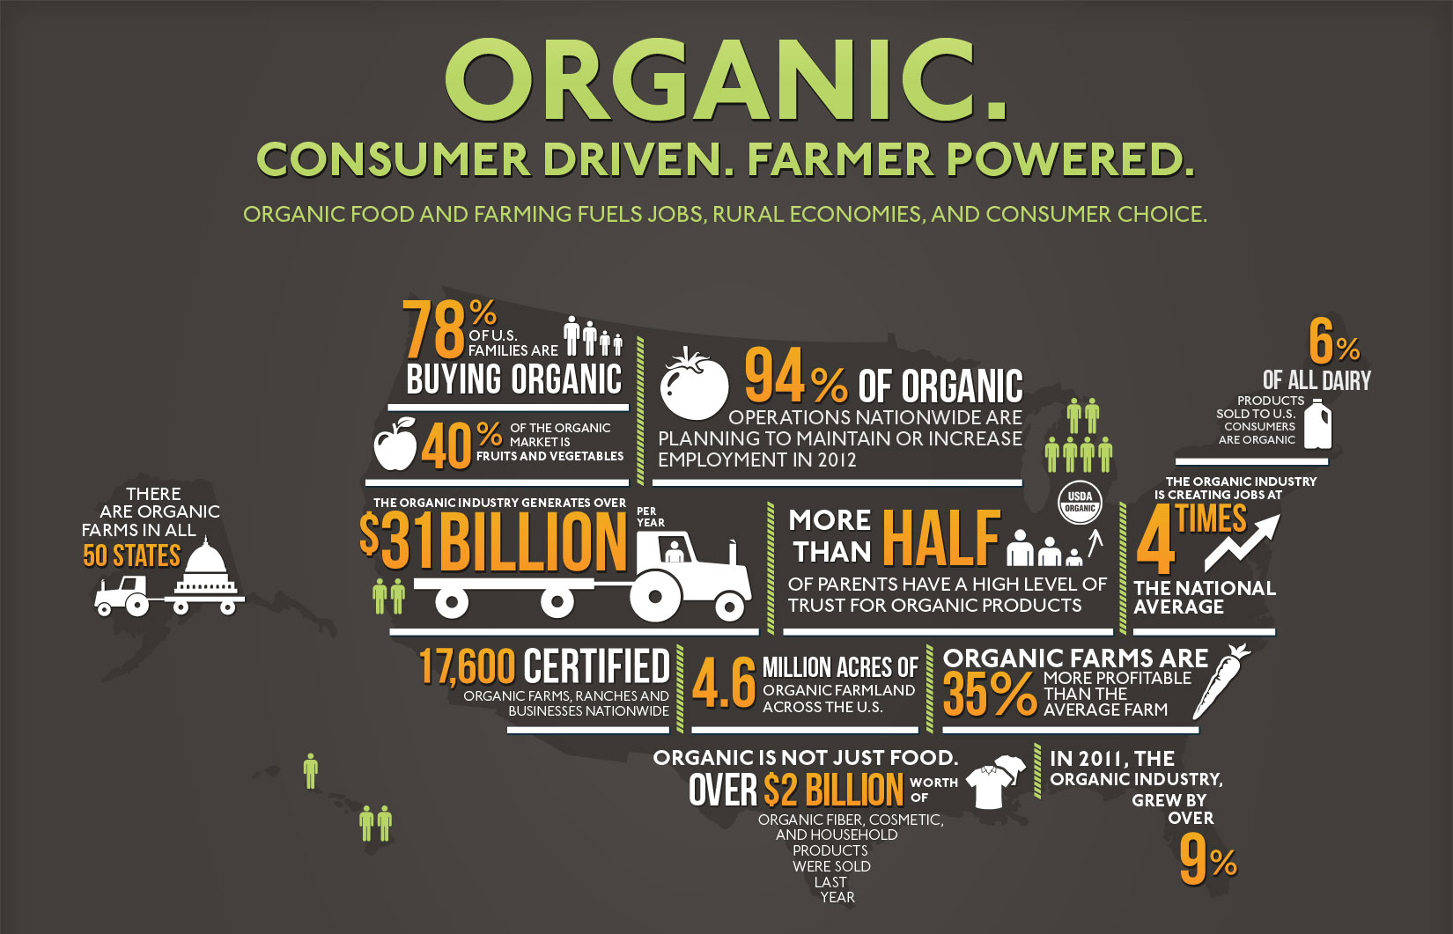
Grocery Industry in the U.S.
Current Trends and Key Takeaways
Market Trends
⬆ Segment revenue: with an annual rate of 0.8%
⬇ Segment profitability: with increasing promotional activity
⬆ New entrants growth: with an annual rate of 0.1%
⬆ M&A activity: to gain economies of scale.
Retail Trends
⬇ Average supermarket square feet
⬆ Natural and organic foods:
7.9% increase from 2015 to 2016
8000 local farms in the USA
50% Americans intend to eat healthier
⬆ Local food: 53% Americans seek out locally grown foods
⬆ Online shopping: 4.5% annual growth
https://www.foodtechconnect.com/wp-content/uploads/2012/05/OTAinfographiclarge1.jpeg
Source: Anon, (2017). “2015 Retail Industry Report”. [online] Available at: http://www.globalmna.com/assets/2015retailindustryreport.pdf [Accessed 29 Oct. 2017].；
Infographic of the Week: Organic Food & Beverage Sales Reach $29.2 Billion in 2011 Available at: https://foodtechconnect.com/2012/05/07/infographic-organic-food-beverages-reaches-29-2-billion-in-2011
Notes:
The Supermarket and Grocery Store Retailer segment has grown over the past five years, benefiting from a strengthening domestic economy.
Supermarkets and grocery stores faced intensifying competition from alternative retailers.
Segment profitability is anticipated to decline as competition from alternative retailers’ heats up, causing operators to offer discounts and promotions.
Consequently, segment revenue is forecast to rise slowly, increasing at an average annual rate of 0.8% to $606.8 billion to 2020.
2015 P47
Show some figures and predict the future.
The Supermarket and Grocery Store Retailer segment has grown over the past five years, benefiting from a strengthening domestic economy as disposable income has grown over this period.
In the future, segment revenue is forecast to rise slowly with 0.8% to $606.8 to 2020 as a result of rising discretionary income and intensifying competitions from alternative retailers. Namely, consumers have increasingly turned toward warehouse clubs and supercenters, such as Costco and Walmart, because of the cost savings and convenience of these retailers. Mass merchandisers are able to offer lower prices due to their scale of operations. In this case, supermarket chains offered substantial discounts and promotions to drive foot traffic to their stores and strengthen consumer loyalty.
Segment revenue is forecast to rise but in a slow pace with an annual rate of 0.8% to $606.8 M to 2020. M&A ⬆️
Rising discretionary income
Slowly increasing Input cost
Consumers trade up to branded and premium product
Intensifying competition from alternative retailers:
Warehouse clubs, supercenter, E-tailers
Compounded by slowly rising input costs, segment profitability is also expected to decline as operators engage in extensive promotional activity. Due to the intensifying competition in the food retailing sector, operators will have to offer steeper discounts and promotions to drive foot traffic to their stores.
Due to increased competition and lower profitability, companies are expected to expand slowly over the next five years. As such, the number of segment enterprises is forecast to rise at an average annual rate of only 0.1% during the five years to 2020.
segment's slow growth in terms of store locations will be merger and acquisition activity. To benefit from economies of scale, the leading operators are anticipated to acquire smaller, regional competitors and merge with larger supermarket chains in the upcoming years. Consequently, establishment growth is expected to be suppressed during the period.
Over the next five years, it’s anticipated that segment profitability to slightly decline as supermarkets face growing price-based competition from alternative retailers.
Segment revenue → rise but in a slower pace with an annual rate of 0.8% to $606.8 M to 2020.
Segment profitability → decline as operators engage in extensive promotional activity
Enterprise number → grow slowly at an average annual rate of only 0.1% to 2020.
M&A activity → increase to gain economies of scale.

Slide 14
Grocery Industry
Dynamics
"Convenient" customers
Supercenters
Kroger
Lidl
Grocery Stores
Walmart
Target
Customers
Profitability ++
Growth ++
Aldi
Profitability +
Growth +
Price sensitive customers
Challenges of Grocery Industry
Supercenters: They are expanding grocery offerings, becoming one-stop shops. → Convenience
Grocery stores & discount stores: PRICE SENSITIVE customers shop locally and in small amounts → Low price

Slide 15
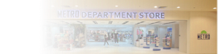
Department Store Industry Analysis
Introduction: U.S. Retail Industry
Grocery Store Industry
KPIs and key characteristics
Porter's 5 Forces
Industry Overview
Department Store Industry
KPIs and key characteristics
Porter's 5 Forces
Industry Overview
Comparison Grocery vs. Department Store
Aldi
Aldi in the Grocery Store Industry
Aldi SWOT Analysis
Recommendation
Strengthen Grocery Store Presence
Store Location
Online Presence
Organic Food Line
U.S. Customer Behavior
Summary

Slide 16
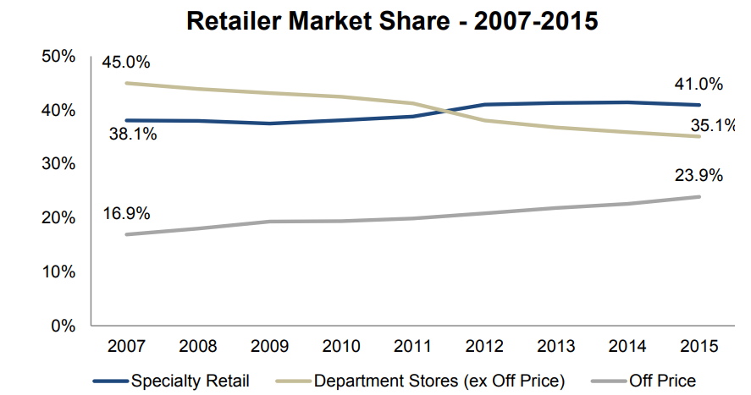
Department Store Industry
Current Situation
Department store market share fell to 35% (2015) from 45% (2007) worldwide
US department store sales have been declining for over 10 years, in total and as a percentage of total retail.
Department
Store
Profit margin: 2.8%
Annual growth: -4.1%
*Equity research, Credit Suisse, 2017
Definition: A retail establishment offering a wide range of consumer goods in different product categories known as “departments”.
Revenue: $252.5 bn (2006) --> $163.58 bn (2015)*
No. of Employees: 1.7 mn (2002) → 1.3mn (2016)*
Key players: Target, Nordstrom, Sears, J.C Penny, Walmart
*Monthly retail trade report, US department of commerce, 2015 & © Statista 2017
*U.S. Bureau of Labor Statistics
Source: Anon, (2017). “2015 Retail Industry Report”. [online] Available at: http://www.globalmna.com/assets/2015retailindustryreport.pdf [Accessed 29 Oct. 2017].

Slide 17
Department Store Industry
Porter’s Five Forces
Threats of New Entrants
Threats of Substitutes
High entrance barriers:
capital requirements (huge stores)
incumbent advantages (experience, positioning, brand)
product differentiation
Substitutes:
online shopping (low switching costs, attractive price-performance trade-off)
supercenters
Intensity of Competitive Rivalry
e.g. Walmart, Sears, JC Penney
Price pressure since:
high fixed costs
low switching costs
rivals are big players
Power of suppliers increases:
many players are leaving → harder to make deals with fair prices
Increasing bargaining power:
low switching costs
consumers more price sensitive since recession
Bargaining Power of Suppliers
Bargaining Power of Buyers
Notes:
First show whole 5 forces, then illustrate each part with detailed figures and summary key features. At the end, gather all the key features and give some conclusion.
Homogenous product -- High competition -- Price war, possible to think of private label to build brand loyalty thus to compete with homogenous product.
In the largest metropolitan areas, the four largest food retailers -- Wal-Mart, Kroger, Costco and Supervalu -- controlled over 70% of the sales.
A Wal-Mart spokesperson said customers are loyal to its private brands, "both in-store and online." "While we are the largest private-brand player in the U.S., we've spent a lot of effort to invest in product development, sourcing, technology and new talent to be able to build an even better business," the spokesperson said in a statement. "These brands help us deliver great prices for our customers, innovative products and quality items that we know our customers are going to love."

Slide 18
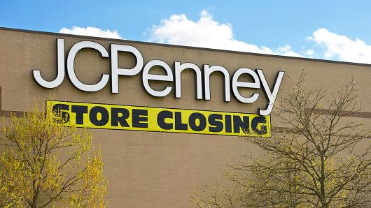

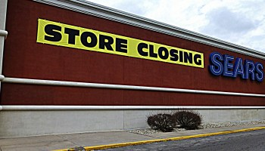
Department Store Industry
Current Trends and Key Takeaways
Segment profitability
still positive, thanks to cuts in expenses (workforce, stores)
eroded by fast fashion, discounters and online shopping (high product overlap)
Trends
Recession has decreased discretionary spending (not essential)
Department stores have reduced size and opened outlet versions

Slide 19
Department Store Industry
Dynamics
Sears
JC Penney
Kohl's
Department Stores
Walmart
Target
Supercenters
Profitability +
Growth --
Profitability ++
Growth ++
How department stores are adapting
expanding grocery offerings (becoming supercenters)
ones with more differentiated brands fare better
improve online stores
reduce real estate
supply chain efficiency

Slide 20
Grocery vs. Department Store
Introduction: U.S. Retail Industry
Grocery Store Industry
KPIs and key characteristics
Porter's 5 Forces
Industry Overview
Department Store Industry
KPIs and key characteristics
Porter's 5 Forces
Industry Overview
Comparison Grocery vs. Department Store
Aldi
Aldi in the Grocery Store Industry
Aldi SWOT Analysis
Recommendation
Strengthen Grocery Store Presence
Store Location
Online Presence
Organic Food Line
U.S. Customer Behavior
Summary

Slide 21
Grocery vs. Department stores
Summary
Grocery Store
Department Store
Key features
Profitability
1.5% (2009-14) → < 1.5% (2014-19)
2.9% (2009-14) → < 2.9% (2014-19)
Annual growth
1.3% (2009-14) → 0.8% (2014-19)
-4.1% (2009-14) → -1.4% (2014-19)
Market share
12.2% (2015)
3.5% (2015)
Five forces
Competitive rivalry
Intensifying competition → price war
High fixed costs → price pressure
Threats of entrants
Low barriers but lack competitiveness
High barriers → no entrants
Threats of substitutes
Internal → healthier | external → cheaper
Supercenters, e-tailers
Conclusion
Stagnant growth and profitability, require cheaper and healthier foods
Decreasing revenues, customers migrate to supercenters and e-tailers
Notes:
Show some figures and predict the future.
The Supermarkets and Grocery Stores industry is in the mature stage of its life cycle.
Intense competition in the food retailing sector has also contributed to the industry's slow growth.
Price is crucial.

Slide 22
Grocery vs. Department stores
Summary
Grocery Store
Department Store
Key features
Profitability
1.5% (2009-14) → < 1.5% (2014-19)
2.9% (2009-14) → < 2.9% (2014-19)
Annual growth
1.3% (2009-14) → 0.8% (2014-19)
-4.1% (2009-14) → -1.4% (2014-19)
Market share
12.2% (2015)
3.5% (2015)
More attractive market
Five forces
Competitive rivalry
Intensifying competition → price war
High fixed costs → price pressure
Threats of entrants
Low barriers but lack competitiveness
High barriers → no entrants
Threats of substitutes
Internal → healthier | external → cheaper
Supercenters, e-tailers
Conclusion
Stagnant growth and profitability, require cheaper and healthier foods
Decreasing revenues, customers migrate to supercenters and e-tailers
Notes:
Show some figures and predict the future.
The Supermarkets and Grocery Stores industry is in the mature stage of its life cycle.
Intense competition in the food retailing sector has also contributed to the industry's slow growth.
Price is crucial.

Slide 23
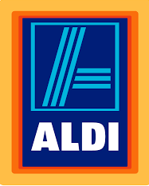
Aldi
Introduction: U.S. Retail Industry
Grocery Store Industry
KPIs and key characteristics
Porter's 5 Forces
Industry Overview
Department Store Industry
KPIs and key characteristics
Porter's 5 Forces
Industry Overview
Comparison Grocery vs. Department Store
Aldi
Aldi in the Grocery Store Industry
Aldi SWOT Analysis
Recommendation
Strengthen Grocery Store Presence
Store Location
Online Presence
Organic Food Line
U.S. Customer Behavior
Summary

Slide 24
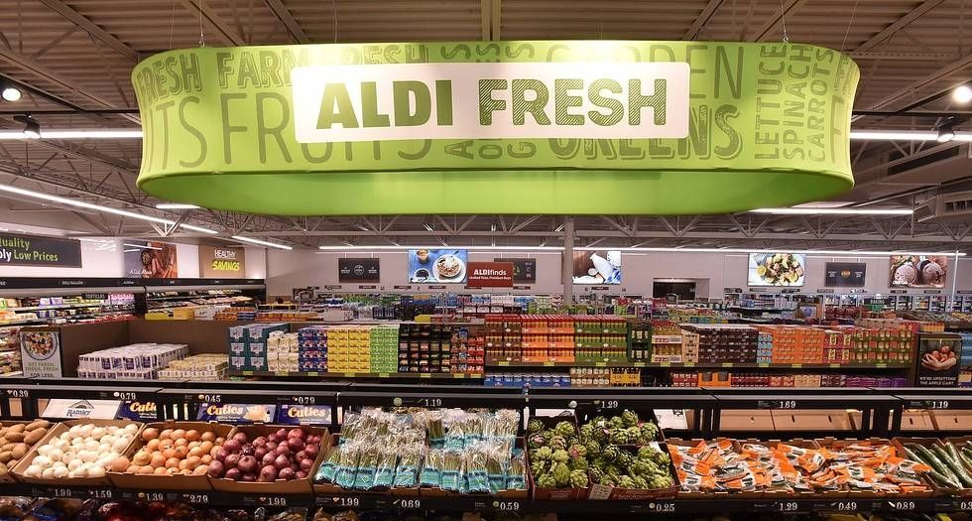
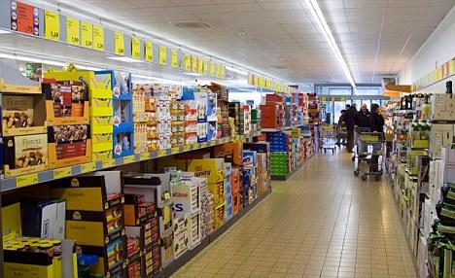
Aldi Culture & Operations
Culture
Operations
Cost Leadership
Small Variety
Frugality
Cross-trained Employees
Low Operation Costs
Aldi
Low Advertisement
Secrecy, low profile
Offer products, not services
High Customer Involvement
Goal: sustained growth → small wins count
Small but growing market share (U.S.)
Growing Revenue (U.S.)

Slide 25
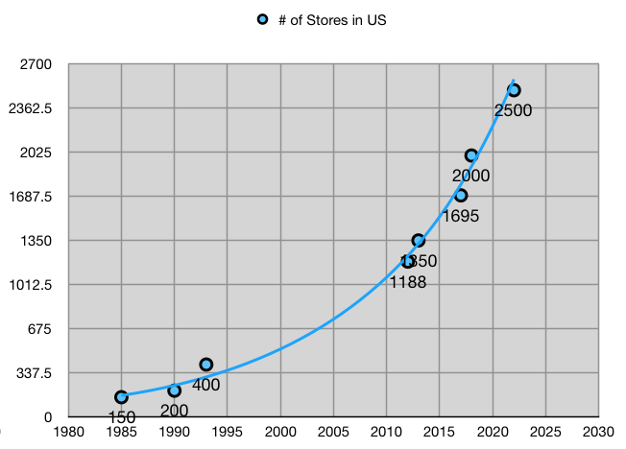
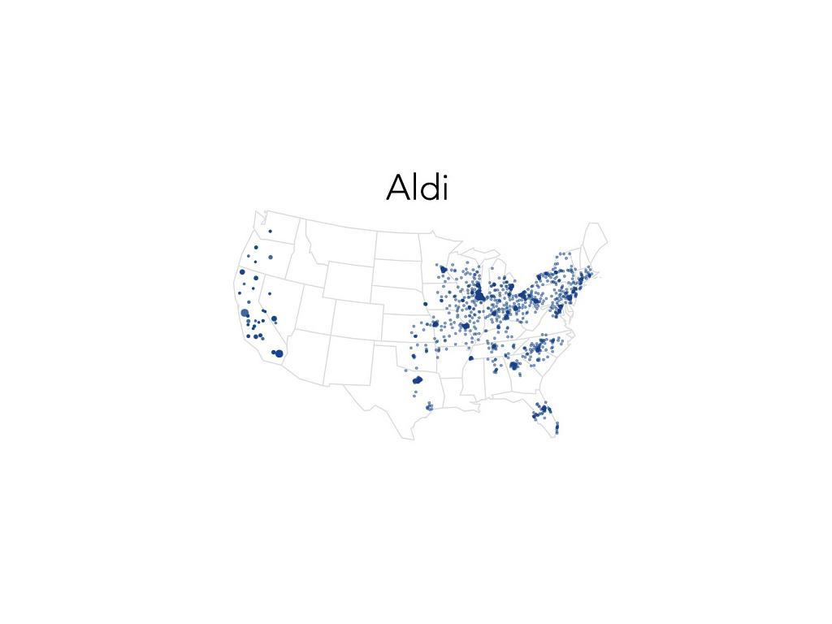
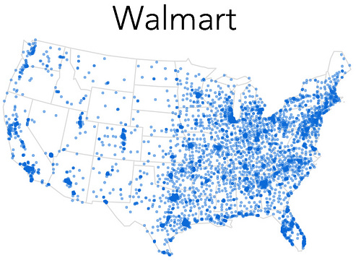
Aldi in the U.S.
No. of Stores and Geographical Coverage in US
Aldi
Walmart
Market Share (Grocery, May 2017)
1.5 %
22 %
Sales Growth (Grocery, May 2017)
15 %
2 %
Ranking (Global retailers, 2012)
8th
1st
Competitive Advantage
Cost leadership
Always low prices
*Based on articles in 2014 @bigthink
*Data extracted from Aldi study case

Slide 26
Aldi SWOT Analysis
STRENGTHS（+）
WEAKNESSES ( - )
High quality products
Majorly private-labeled goods: 95% of portfolio
Low prices: 20% cheaper than Walmart, 2013
Value for money: 80% of price is purchase price
Limited product portfolio: 1,400SKUs per 17,000 square foot store
Low brand recognition
Low level of customer service
INTERNAL
Geographical expansion: 80 to 130 stores per year
Organic food: 82% of households will buy
Online shopping
Intense competition: price war
Substitutes: supercenters, warehouse clubs
New entrants : Lidl
EXTERNAL
OPPORTUNITIES（+）
THREATS ( - )
Notes:
First show whole 5 forces, then illustrate each part with detailed figures and summary key features. At the end, gather all the key features and give some conclusion.

Slide 27
Recommendation for Aldi’s expansion strategy
Introduction: U.S. Retail Industry
Grocery Store Industry
KPIs and key characteristics
Porter's 5 Forces
Industry Overview
Department Store Industry
KPIs and key characteristics
Porter's 5 Forces
Industry Overview
Comparison Grocery vs Department Store
Aldi
Aldi in the Grocery Industry
Aldi SWOT Analysis
Recommendation
Strengthen Grocery Store Presence
Store Location
Online Presence
Organic Food Line
U.S. Customer Behavior
Summary

Slide 28
Recommendation
Avoid Department Store Segment, Focus on Groceries
No Department Stores !
Differentiation through exclusive brands goes against Aldi culture and competitive strategy
High service level and costly operations against Aldi culture
High product overlap with online retailers
High investment
Department Stores
Profitability +
Growth --
Strengthen Grocery Stores
Aldi has know-how and experience in grocery store and loyal suppliers
REAL cost leader in grocery market
Online retailers lesser threat to grocery stores
Many growth options: e.g. organic food
Grocery Stores
Profitability +
Growth +
Why Not Supercenters?
Extremely high investment, no experience
Vulnerable to e-tailers
Can only be supported by high demands
Aldi's target: low budget, price sensitive customers
Supercenters
Profitability ++
Growth ++

Slide 29
Recommendation
Dynamics
Remain Here!
Supercenters
Profitability ++
Growth ++
"Convenient" customers
Department Stores
Sears
JC Penney
Kohl's
Kroger
Lidl
Grocery Stores
Profitability +
Growth --
Walmart
Target
Customers
Profitability +
Growth +
Aldi
Price sensitive customers
Notes:
Expansion to department store is risky due to large expense in employee management and technology and product development.
Customer-driven offers and promotions;
Development of e-grocery;
Stay in grocery industry but put more effort in customer preference insight (organic food, convenient to access);
New supply chain.

Slide 30
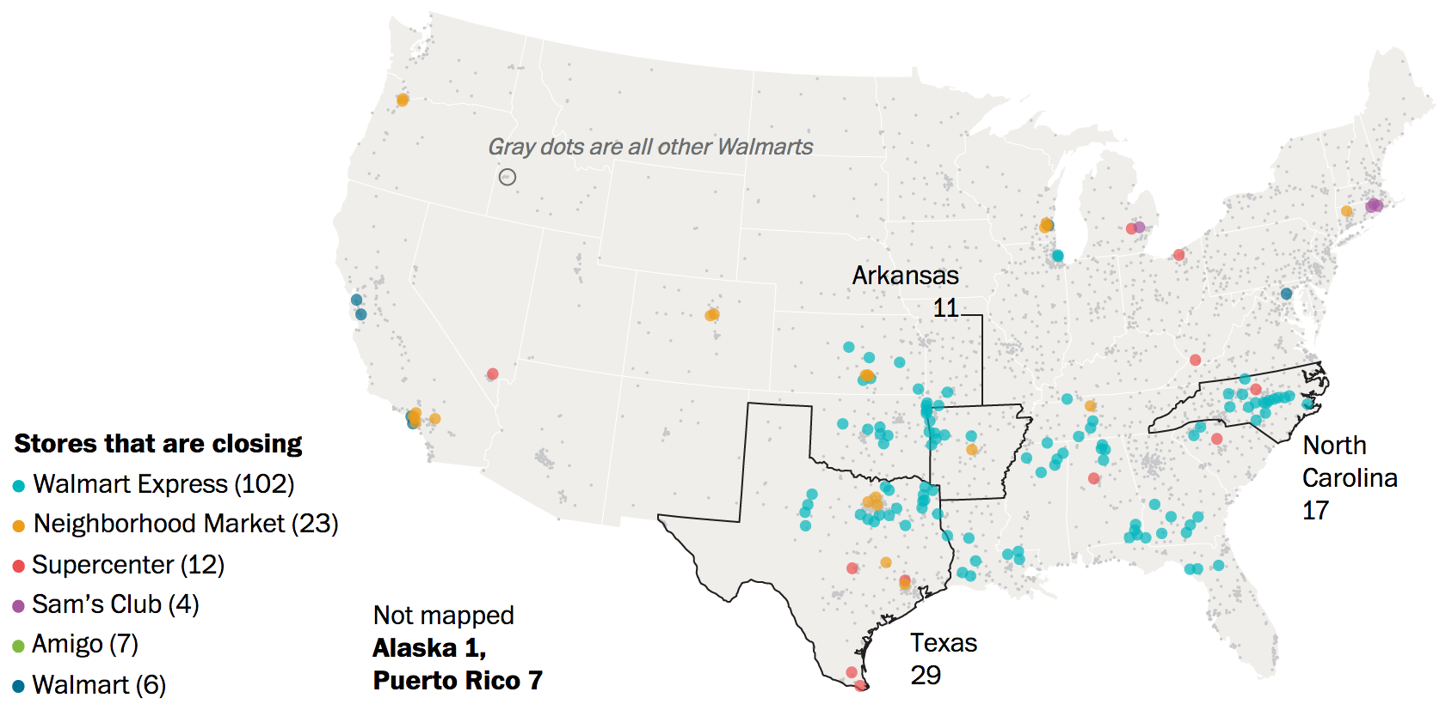
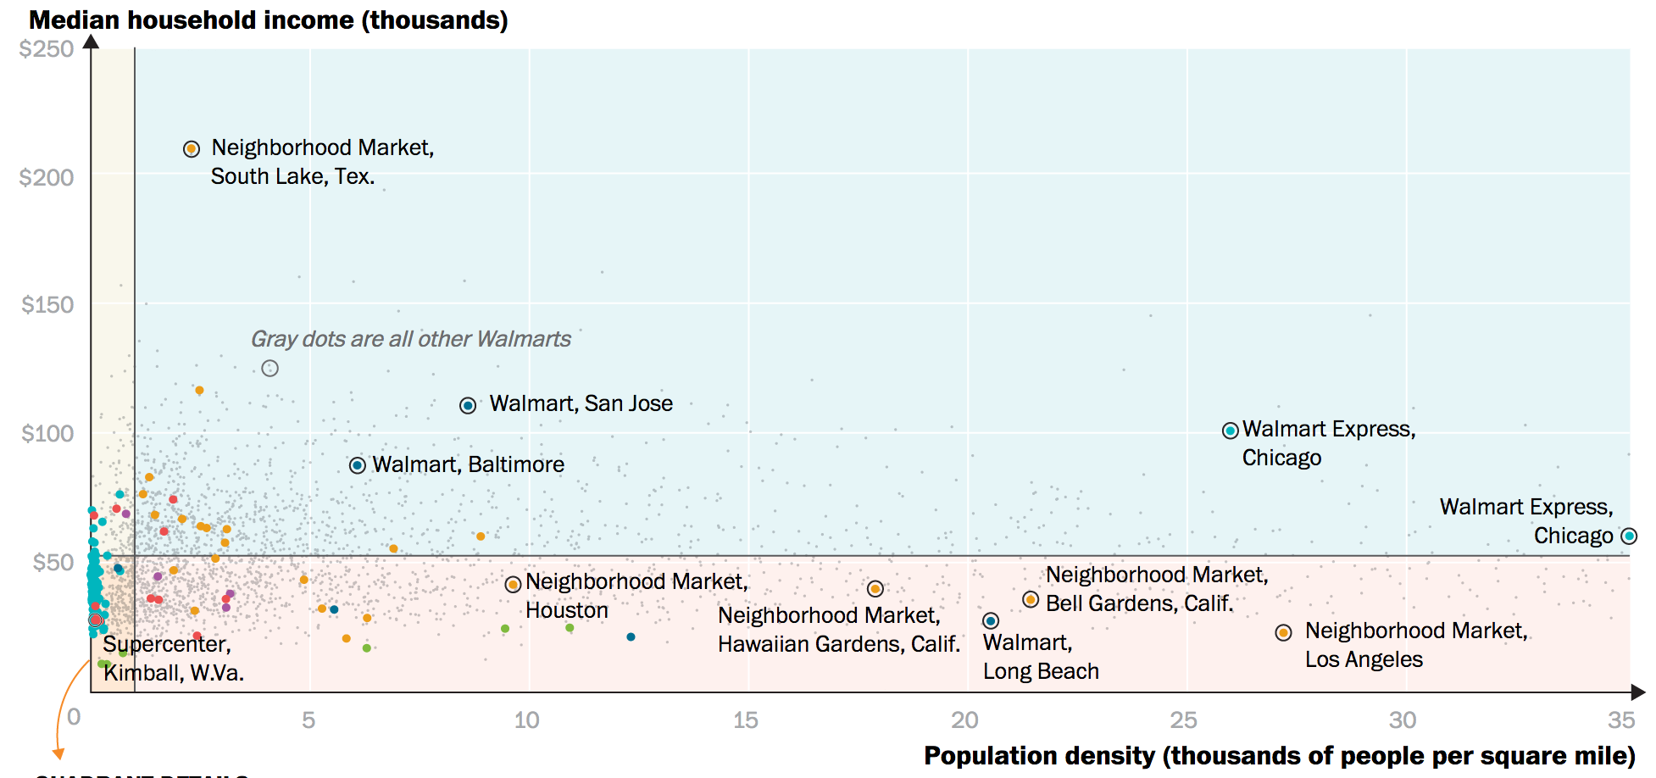
Recommendation
Location of Stores
"Poor, rural areas will be most affected by Walmart closing stores"
Lessons to Learn
Walmart could not compete with dollar stores (low income)
Supercenters were too big (low density)
Consumer trends
Low income / price sensitive consumers shop locally (high gas prices) and often rather than big.
Source: Washington Post. (2017). Poor, rural areas will be most affected by Walmart closing 154 stores. [online] Available at: https://www.washingtonpost.com/graphics/business/walmart-closings/ [Accessed 29 Oct. 2017].
Notes:
2 Options:
Either locate stores near walmart supercenters.
Advantage: attract budget-constrained customers away from walmart
Disadvantage: less products, customers would have to visit both stores to purchase everything
Locate stores near walmart express and neighborhood stores
Advantage: have similar product variety but cheaper, avoid supercenter saturated areas
Disadvantage: access to less customers
Go west
Go for big cities

Slide 31
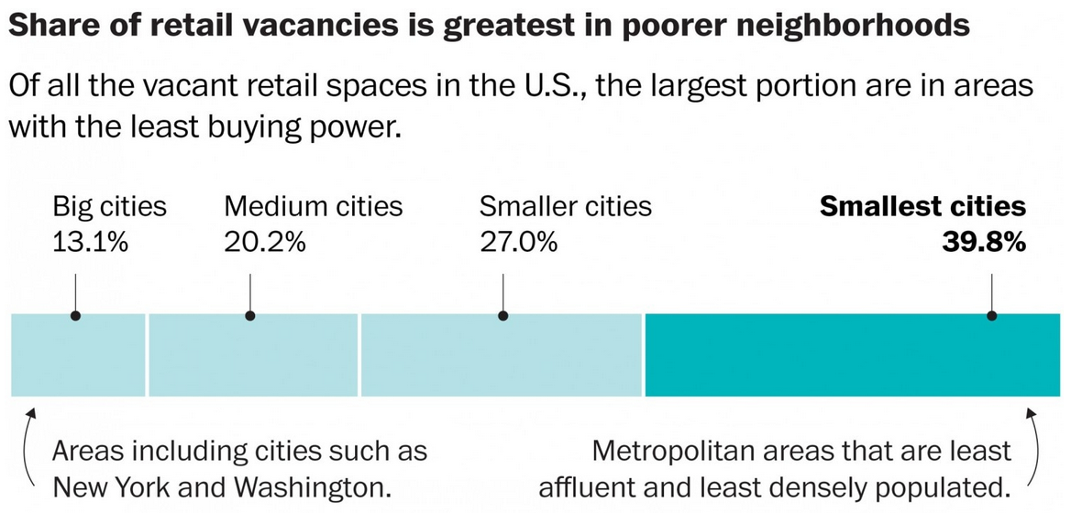
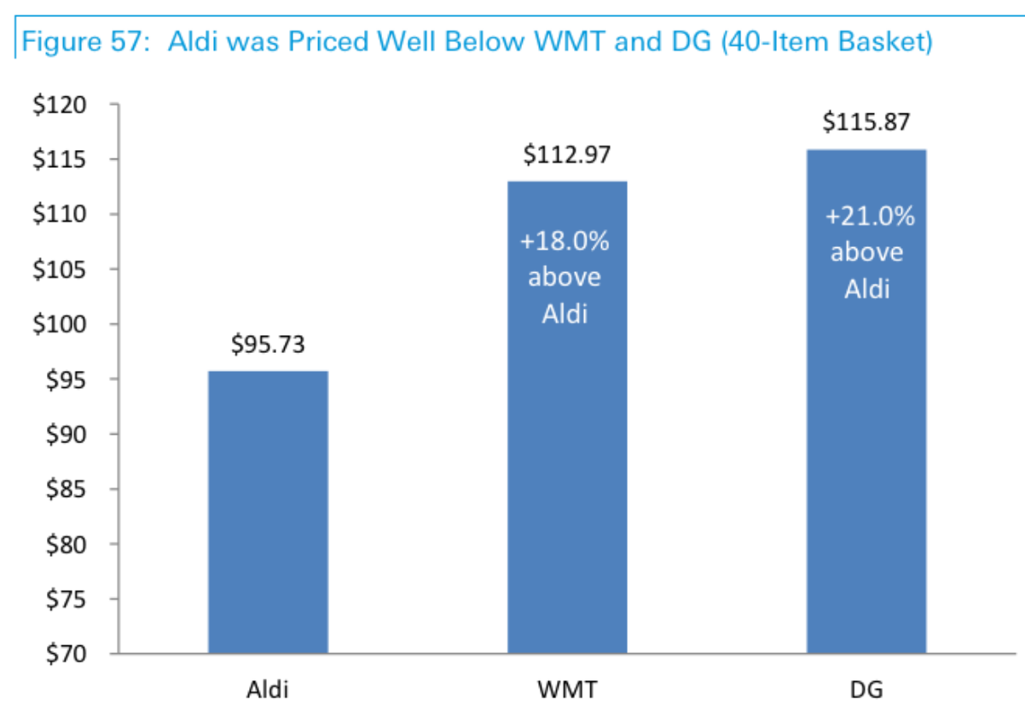

Recommendation
Location of Stores
Crack Well-guarded Markets
Crack Well-guarded Markets: Attack Weak Spots, than Strongholds
Leverage assets
Reconfigure value chain
Undersupplied niche market
Solution
Aldi is cheaper than dollar stores (Dollar General)
Tackle low income, both high and low density areas as long as demand is sufficient
Gradually target mainstream markets: Walmart neighborhood stores (urban areas, high density)
Source: Washington Post. (2017). There really are too many stores. Just ask the retailers.. [online] Available at: https://www.washingtonpost.com/news/business/wp/2016/04/05/there-really-are-too-many-stores-just-ask-the-retailers/?utm_term=.ecf527cd5281 [Accessed 29 Oct. 2017].
Source: Peterson, H. (2017). Aldi is shockingly cheaper than Dollar General. [online] Business Insider. Available at: http://uk.businessinsider.com/aldi-is-shockingly-cheaper-than-dollar-general-2016-4?r=US&IR=T [Accessed 29 Oct. 2017].

Slide 32
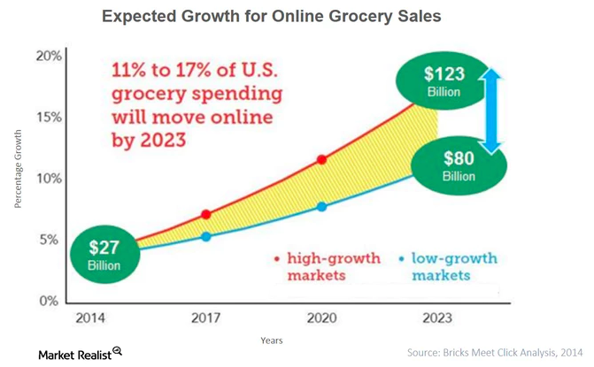
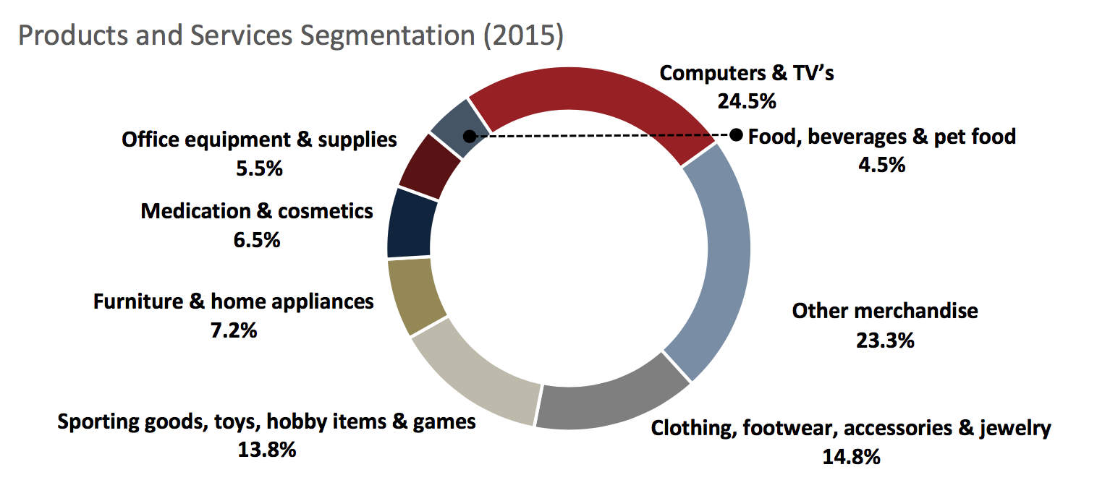
Recommendation
Seek opportunity of online-retail in the long-term
E-tailers’ segment portfolio
In the short run
No fully online shopping:
Less vulnerable to e-tailers:
online sales = 4.6% of total grocery sales(2014).
E-commerce is not well suited:
low price-to-weight ratio, hard to keep fresh.
Cooperate with 3rd party delivery
Test 1 hour food delivery in three city as the 1st step.
In the long run
Online shopping:
Big profitability and high growth potential in the market
Future trend: Millennials has affinity to use E-commerce
Future digital solution: search feasible online operation model. e.g. home delivery, in-store pickup, drive-through pickup.
Current digital solution: mobile coupons, mobile shopping list.
Source: Anon, (2017). “2015 Retail Industry Report”. [online] Available at: http://www.globalmna.com/assets/2015retailindustryreport.pdf [Accessed 29 Oct. 2017].； The Kroger Co.: From Corner Store to Supermarket Giant Available at http://marketrealist.com/2015/10/online-grocery-retail-a-future-sales-driver-for-kroger/
Notes:
Online retailers are a much bigger threat to department stores Because e-tailers products cover many department store products. Therefore, grocery stores are less threatened by e-tailers. Moreover, Food is hard to ship, stay fresh, expensive to deliver. And Aldi has no experience, not their focus, high investment.
Segment revenue has grown 10.3% to $297.9 billion in 2015, a big market in the future
Toughly $1.1 billion online food sale, account for 1.7% of grocery & supermarket revenue, still a small ratio
E-commerce is well suited to specialty retailing because it allows companies to offer greater product selection in a category than would typically be available in brick-and-mortar stores.
Products with steady consumption rate and long shelf life, high price-to-weight ratio,
stock-up
Expansion the delivery line is costly, including supply chain, logistic, warehouse and manual fees.
Millennials has affinity to use E-commerce in the future.

Slide 33
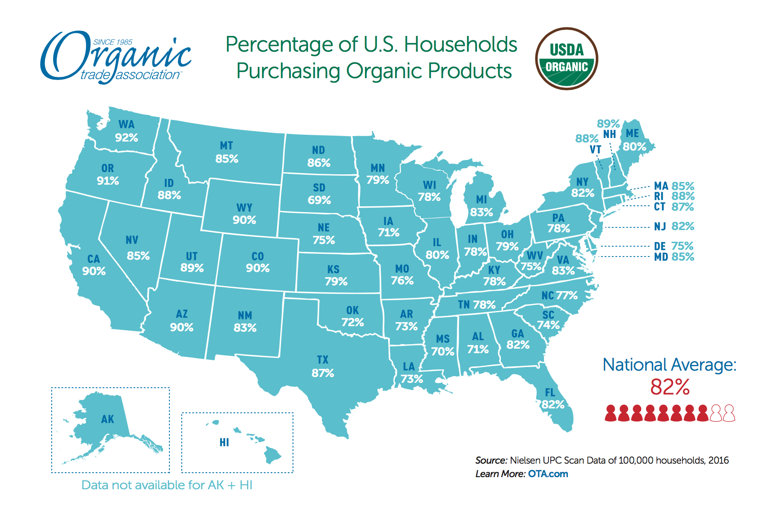
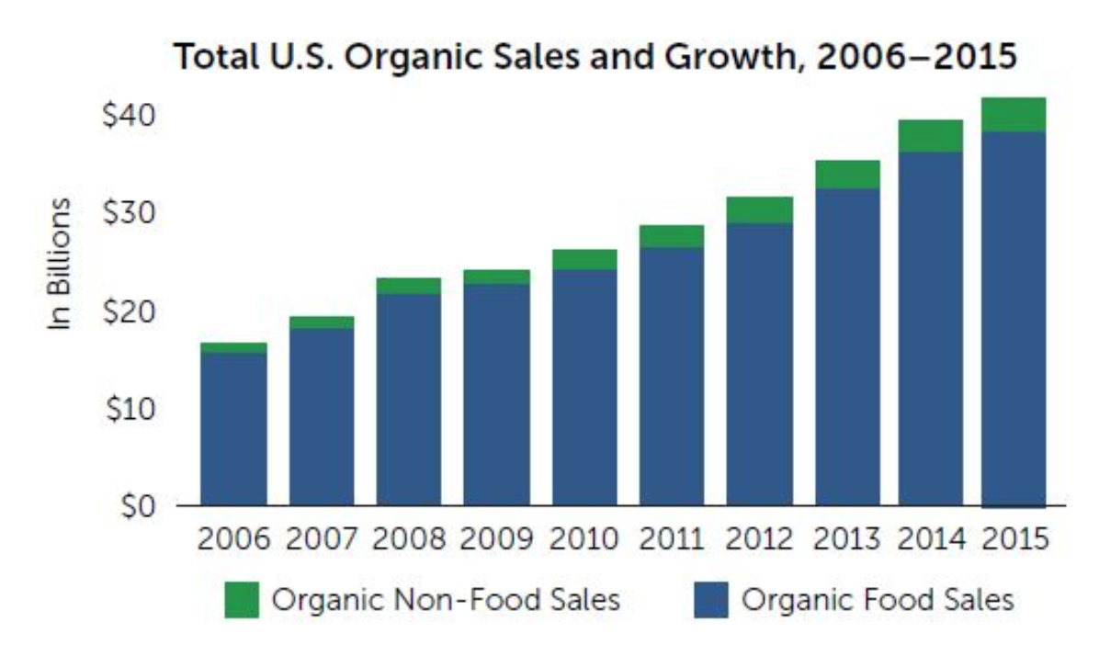
Recommendation
Extend organic products line
Preference towards organic food in the U.S.
82% households purchase organic products
5.3% of food sale is organic, grow at a rate of 7.9%.
25% of American population is millennials, who have strong affinity for organic food.
Aldi’s position in organic product line
25% cheaper and high quality organic food since 2013.
>72 USDA certificated organic food items at Aldi.
On the way to go full organic.
Solution
Advertise on social media: promote Aldi organic brands.
Cooperate with local farms: improve organic food line.
Noticeable organic labeling and layout
Keep low price competitive advantage
Source:News:
U.S. organic sales post new record of $43.3 billion in 2015 Available at. https://www.ota.com/news/press-releases/19031
Notes:
In the U.S., average 82% households purchase organic products
Organic segment accounts for 5.3% of food sale, increase 7.9% from 2015 to 2016
Millennials accounts for 25% of American population, 80% will be parents in the following 10 years, deepen the strong affinity for organic shared.
Aldi goes full organic, banned 8 pesticides from 1st. January 2017
72 organic food at Aldi, USDA Organic seal: >95% certified organic contents
Advertise on website and shared on social medium to enhance people’s awareness about Aldi
http://www.dontwasteyourmoney.com/aldi-vs-whole-foods-stores-organic-options-better-wallet/

Slide 34
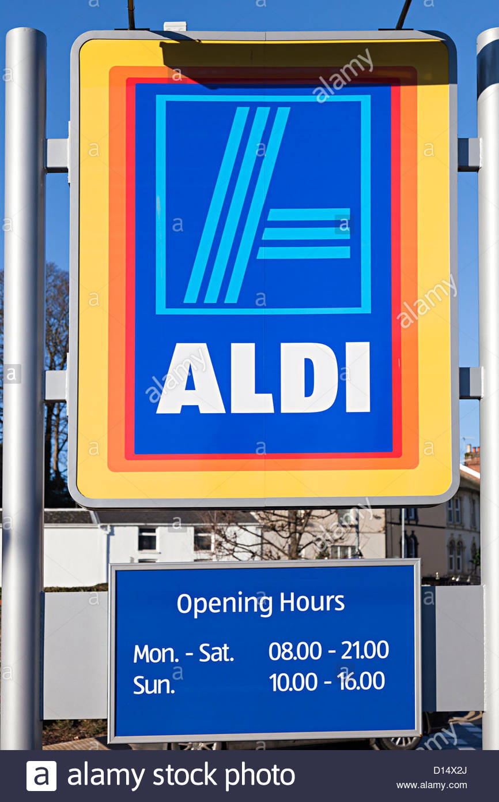

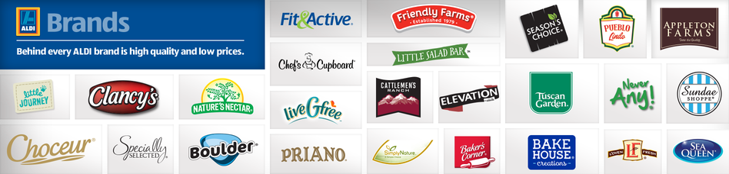
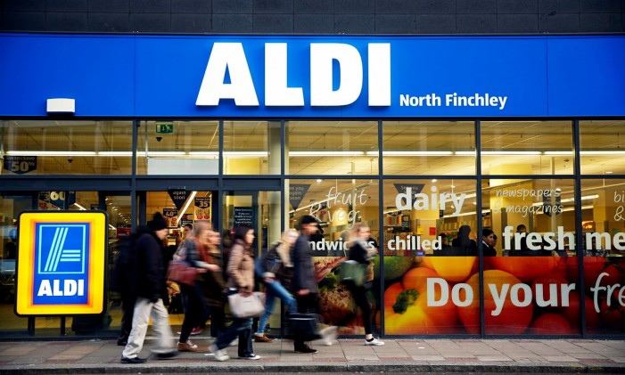
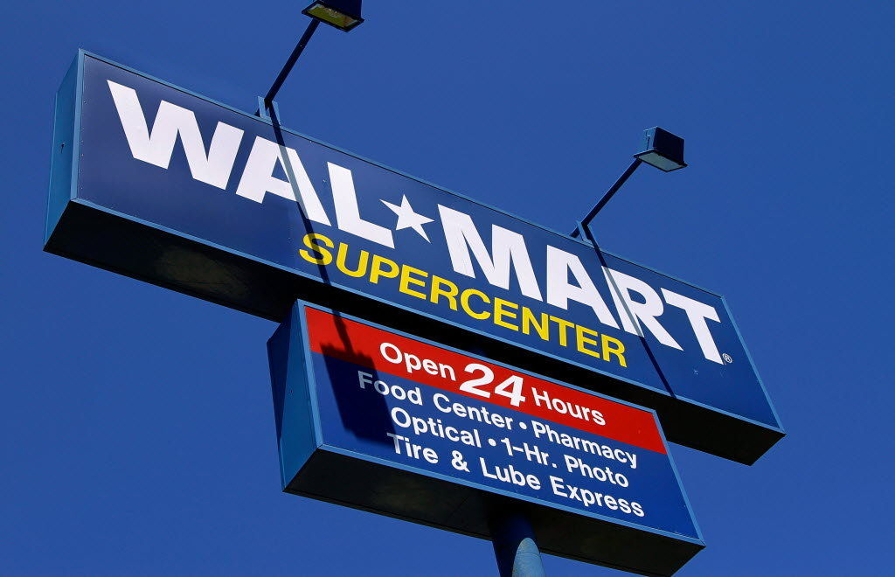
Recommendation
Adapt to U.S. customer behavior
Make Carts Coin-free
Extend Opening Hours
Expand Product Portfolio (eg. by 5%)
Focus on Private Labels
Notes:
Extend opening hours (currently Mon - Sat 9 / 10 am for 10 hours and Sun 12 am for 5 hours) americans go early, or really late, especially on sundays
Include more national labels without compromising private label majority, since Americans are really loyal to certain brands.
Extend product portfolio by certain percentage (ex 10%) without compromising focus on cost leadership. This will allow them to compete with Walmart neighborhood stores and express stores (more variety AND cheaper). That's what they did in the UK and it seems to be working. Slow growth but sustained (one of Aldi's cultural goals)
Make carts free (no coin needed)
Use attracting price tags to encourage customers to buy in bulk.
Promotions and coupons.
Self-checkout registers.
VIP card for discount.
Size?
While many consumers have gravitated toward branded organic goods, others have increasingly turned to generic brands over the past five years. After reaching an all-time high during the recession, sales of private label food have stabilized at a new high, according to Booz and Company. Generic brands used to be perceived as subpar compared to national brands, but about half of consumers now believe store brands possess the same quality as branded goods. Furthermore, the introduction of premium generic brands, such as Whole Foods' 365 Every Value Organic, has boosted consumers' perception of generic products.

Slide 35
Summary
Introduction: U.S. Retail Industry
Grocery Store Industry
KPIs and key characteristics
Porter's 5 Forces
Industry Overview
Department Store Industry
KPIs and key characteristics
Porter's 5 Forces
Industry Overview
Comparison Grocery vs Department Store
Aldi
Aldi in the Grocery Industry
Aldi SWOT Analysis
Recommendation
Strengthen Grocery Store Presence
Store Location
Online Presence
Organic Food Line
U.S. Customer Behavior
Summary

Slide 36

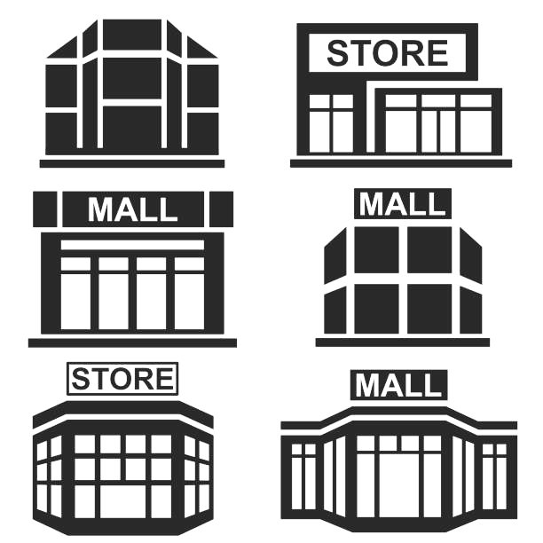


Summary
Department Store Industry has stable positive profit and negative growth, with competition issues
Grocery Store Industry is mature and has stable profit
In general, grocery store industry is more attractive. However, some changes have to be made to achieve sustained growth
Grocery Stores
vs
Department Stores
vs
Aldi’s
Opportunities & Threats in US
➕ Operations efficiency, cost leadership and high quality private-label goods
➖ Low technology inclination, lack of service dimension, relatively small player
Forget DS, focus on groceries
Corporate & enhance organic food line
Adapt to U.S. customer behavior
Short term
Medium term
Long term
Recommendations for Aldi in US
Open new stores & Tackle price sensitive customers
Test food delivery with 3rd party
Seek opportunity of fully online-retail
Notes:
Customer-driven offers and promotions;
Development of e-grocery;
Stay in grocery industry but put more effort in customer preference insight;
New supply chain.

Slide 37
References
Anon, (2017). [online] Available at: https://www.duffandphelps.com/assets/pdfs/publications/mergers-and-acquisitions/industry-insights/consumer/food-retail-industry-insights-2016.pdf [Accessed 29 Oct. 2017].
Studylib.net. (2017). Supermarket & Grocery Industry. [online] Available at: http://studylib.net/doc/5577798/supermarket-and-grocery-industry# [Accessed 29 Oct. 2017].
Marketrealist.com. (2017). Online Grocery Retail: A Future Sales Driver for Kroger - Market Realist. [online] Available at: http://marketrealist.com/2015/10/online-grocery-retail-a-future-sales-driver-for-kroger/ [Accessed 29 Oct. 2017].
Ota.com. (2017). U.S. organic sales post new record of $43.3 billion in 2015 | OTA. [online] Available at: https://www.ota.com/news/press-releases/19031 [Accessed 29 Oct. 2017].
Gould, D. (2017). Infographic of the Week: Organic Food & Beverage Sales Reach $29.2 Billion in 2011 | Food+Tech Connect. [online] Food+Tech Connect. Available at: https://foodtechconnect.com/2012/05/07/infographic-organic-food-beverages-reaches-29-2-billion-in-2011/ [Accessed 29 Oct. 2017].
Anon, (2017). [online] Available at: https://www.nielsen.com/content/dam/nielsenglobal/vn/docs/Reports/2015/Nielsen%20Global%20E-Commerce%20and%20The%20New%20Retail%20Report%20APRIL%202015%20(Digital).pdf [Accessed 29 Oct. 2017].
Clark Howard. (2017). America’s grocery stores ranked from best to worst. [online] Available at: http://clark.com/shopping-retail/food-restaurants/americas-grocery-stores-ranked-from-best-to-worst/ [Accessed 29 Oct. 2017].
Anon, (2017). [online] Available at: http://clark.com/shopping-retail/food-restaurants/americas-grocery-stores-ranked-from-best-to-worst/https:/www.franchisehelp.com/industry-reports/retail-industry-report/ [Accessed 29 Oct. 2017].
Southwick, N. (2017). Aldi Vs. Whole Foods: Which Store's Organic Options Are Better For Your Wallet?. [online] Don't Waste Your Money. Available at: http://www.dontwasteyourmoney.com/aldi-vs-whole-foods-stores-organic-options-better-wallet/ [Accessed 29 Oct. 2017].
Smallbusiness.chron.com. (2017). The Difference Between Grocery, Supermarket, & Hypermarket Merchandisers. [online] Available at: http://smallbusiness.chron.com/difference-between-grocery-supermarket-hypermarket-merchandisers-75675.html [Accessed 29 Oct. 2017].

Slide 38


Thank you for your attention!
Strategic Management Course
Case Study: Aldi
Group A2: Li, Xiang Tseng, Thomas Xu, Hong Yang, Xingyu Yang, Xuechun
30th Oct 2017
Zurich, Switzerland

Slide 39
Appendix

Slide 40
Grocery Industry in the U.S.
Porter’s Five Forces
Threats of New Entrants
Threats of Substitutes
Concentration
Pre-existed relation
Technology Change
Life Cycle Stage(Mature)
Regulation Policy
Capital Requirement
Internal Substitutes: Organic, Natural foods
External Substitutes: Warehouse Clubs, Supercenters
Buyers’ propensity to substitute:
Higher per capita disposable income, Stronger concern towards health issue, Lower Switching cost
Intensity of Competitive Rivalry
e.g. The Kroger.Co
Safeway Inc
Barrier to entry is relatively low, but have to face enormous competitors followed
Low market concentration.
Low diversity of competitors.
→ FIerce competition
Homogeneous products.
Low demand for advertisement.
High information transparency.
→ Price war
Specialized in organic or natural foods and one-stop-shop will become powerful competitors
Suppliers switching costs relative to firm switching costs is high due to loss of volume and profitability.
Suppliers concentration to firms concentration ratio is high due to the emerging substitute inputs.
Emerging new distribution channels make suppliers’ bargaining power higher.
Customers are loyal to Wal-Mart private label because of their great effort in product development, sourcing, technology and new talent.
Food retail consolidation --lower bargaining power of buyers.
Buyer switching costs mainly depend on the transportation fee and time.
Bargaining Power of Suppliers
Bargaining Power of Buyers
Notes:
First show whole 5 forces, then illustrate each part with detailed figures and summary key features. At the end, gather all the key features and give some conclusion.
Homogenous product -- High competition -- Price war, possible to think of private label to build brand loyalty thus to compete with homogenous product.
In the largest metropolitan areas, the four largest food retailers -- Wal-Mart, Kroger, Costco and Supervalu -- controlled over 70% of the sales.
A Wal-Mart spokesperson said customers are loyal to its private brands, "both in-store and online." "While we are the largest private-brand player in the U.S., we've spent a lot of effort to invest in product development, sourcing, technology and new talent to be able to build an even better business," the spokesperson said in a statement. "These brands help us deliver great prices for our customers, innovative products and quality items that we know our customers are going to love."

Slide 41
Department Store Industry
Porter’s Five Forces
Threats of New Entrants
Threats of Substitutes
high entrance barriers:
capital requirements: department stores need huge locations and infrastructure. Initial investment is very high
incumbent advantages (experience, positioning, brand)
product differentiation: entrants would have to match differentiation of incumbents to be competitive
online shopping (low switching costs, attractive price-performance trade-off)
Supercenters include all departments of department stores with additional advantage of groceries
Intensity of Competitive Rivalry
e.g. Walmart, Sears, JC Penney
price pressure since:
high fixed costs
low switching costs
rivals are big players
many players are leaving, power of suppliers increases, making deals with fair prices harder
- buyers have low switching costs to online shopping or supercenters - trend: become more price sensitive due to crisis (groceries represent bigger slice of income)
Bargaining Power of Suppliers
Bargaining Power of Buyers
Notes:
First show whole 5 forces, then illustrate each part with detailed figures and summary key features. At the end, gather all the key features and give some conclusion.
Homogenous product -- High competition -- Price war, possible to think of private label to build brand loyalty thus to compete with homogenous product.
In the largest metropolitan areas, the four largest food retailers -- Wal-Mart, Kroger, Costco and Supervalu -- controlled over 70% of the sales.
A Wal-Mart spokesperson said customers are loyal to its private brands, "both in-store and online." "While we are the largest private-brand player in the U.S., we've spent a lot of effort to invest in product development, sourcing, technology and new talent to be able to build an even better business," the spokesperson said in a statement. "These brands help us deliver great prices for our customers, innovative products and quality items that we know our customers are going to love."

Slide 42


Grocery Industry
Summary
✤ Mature industry ←→ Economies of Scale ←→ M&A activities
✤ $600 B market ←→ Steady growth around 1%
✤ Low profit margin ←→ Stable around 1.5%
✤ Pre-existed trust and loyalty between suppliers and stores
✤ Low entry requirement but hard to compete with key players
Key features
✿ Specialized in organic and natural foods ←→ higher premium
✿ Investment in promoting private labels ←→ consumers loyalty
✿ Investment in online service ←→ changing purchasing method
✿ Investment in R&D ←→ technology reduces fixed cost and waiting time
Opportunity
✭ Intensifying competition from alternative competitors: warehouse, supercenters
✭ Increasing of a variety of retailers: price wars result in stagnating profitability
✭ Harder to negotiate with suppliers due to increase of stores
Threats
Notes:
Show some figures and predict the future.
The Supermarkets and Grocery Stores industry is in the mature stage of its life cycle.
Intense competition in the food retailing sector has also contributed to the industry's slow growth.
Price is crucial.

Slide 43
Grocery vs. Department stores
Criteria | Grocery | Department store
Profitability(profit margin) | 1.5% (2009-14) → <1.5%(2014-19) | 4.1% (2015)
Annual growth rate | 1.3% (2009-14) → 0.8%(2014-19) | -4.5% (2015)
Market share (of retail) | 12.2% | 3.5%
Life cycle stage | Maturity (IVA: +0.6%) | Decline (IVA: -4.6%)
Intensity of competitive rivalry | High → price war | High
Threats of new entrants | High → but with low competition power | Low
Threats of substitute | High → Specialized stores, one-stop-shop, local farmers | High → online stores, specialized retail
Bargaining power of supplier | Low → high switching cost and concentration
Bargaining power of buyers | Low → customer loyalty and food retail consolidation | Low switching costs Price sensitive
Market opportunity | Many: organic food, private label, online store

Slide 44
Aldi SWOT Analysis
STRENGTHS（+）
WEAKNESSES ( - )
High quality products (14 of 21 products equal or better than national brands)
Majorly private-labeled goods (95% of portfolio)
Low prices (20% cheaper than Walmart, 2013)
Customer ranking (4th best grocery store in the U.S.)
Operations efficiency → value for money (80% of customer price is purchase price)
Limited product portfolio (essentials) (about 1,400SKUs per 17,000 square foot store)
Low brand recognition
Online presence
Low IT investment (scanners installed 20 years after Walmart)
Low level of customer service (a coin for shopping carts deposited and returned)
INTERNAL
Geographical expansion (80 to 130 stores per year, from coast to coast)
Organic food (82% of households)
Online market
New technology: self-checkout
Strengthening economy
Intense competition → price war
Substitutes → supercenters, warehouse clubs
New entrants → e.g. Lidl
EXTERNAL
OPPORTUNITIES（+）
THREATS ( - )
Notes:
First show whole 5 forces, then illustrate each part with detailed figures and summary key features. At the end, gather all the key features and give some conclusion.

Slide 45
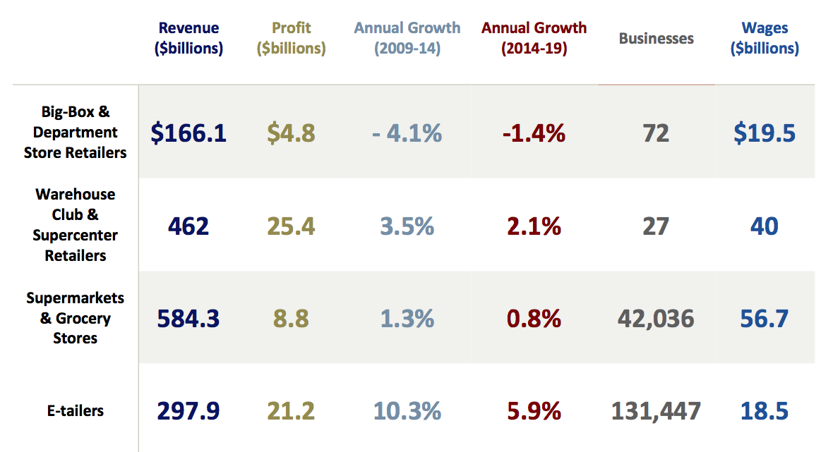
Segments overview

Slide 46
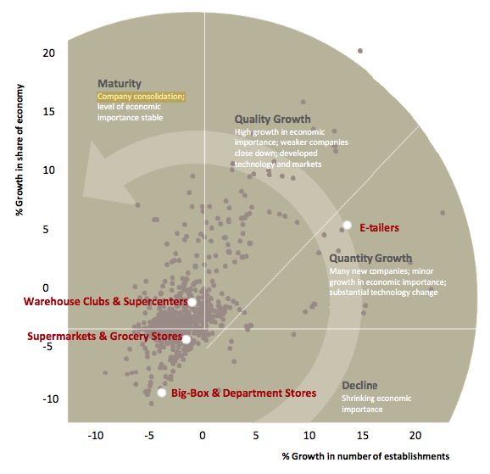
Segments overview

Slide 47
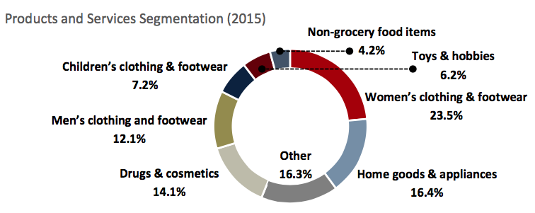
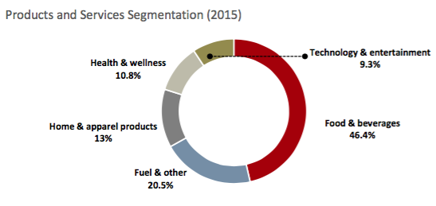
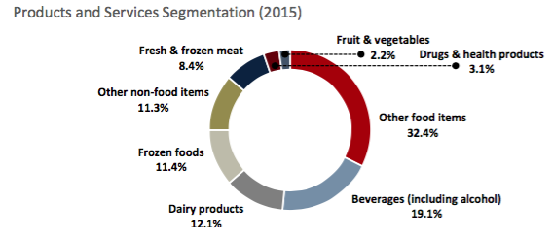
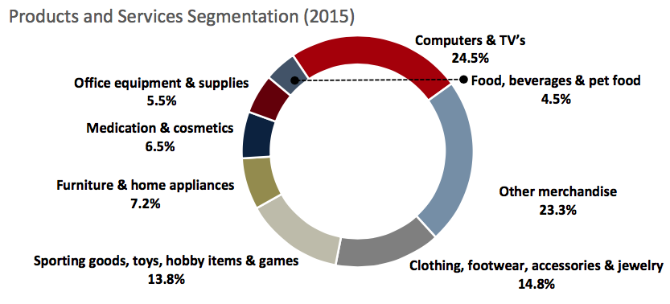
Segments overview

Slide 48
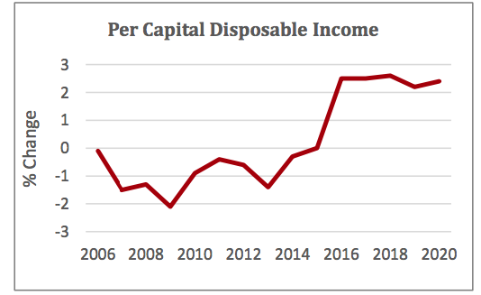

Macro insights

